Slide 1
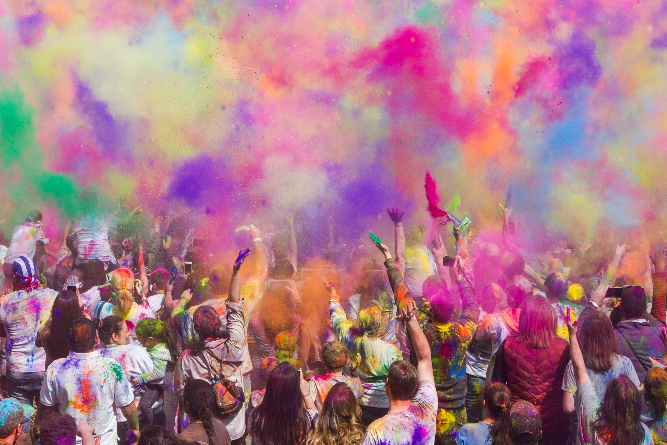

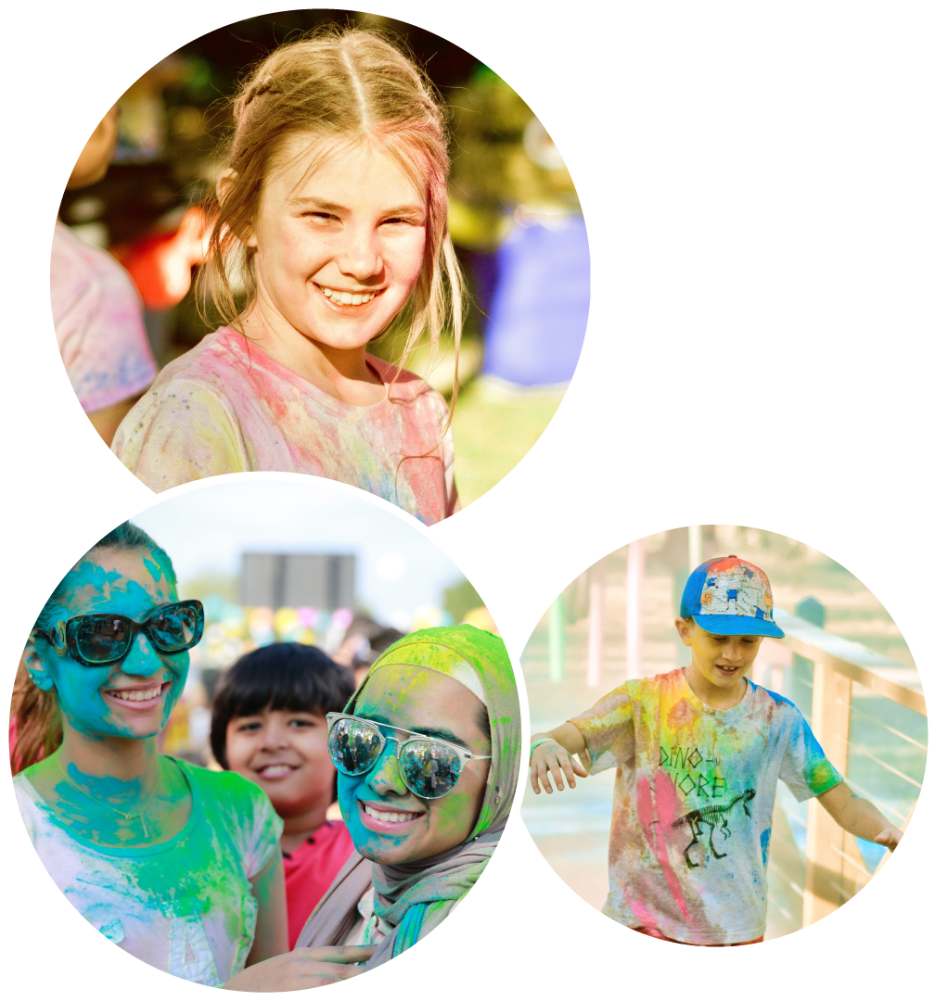


JOIN OUR
PRIMARY SCHOOLS
COLOUR RUN

Slide 2
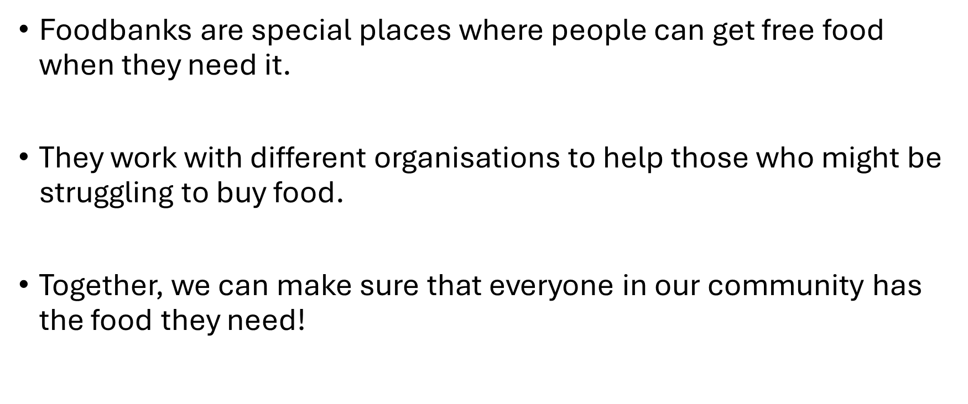
What is Luton Foodbank?

Slide 3
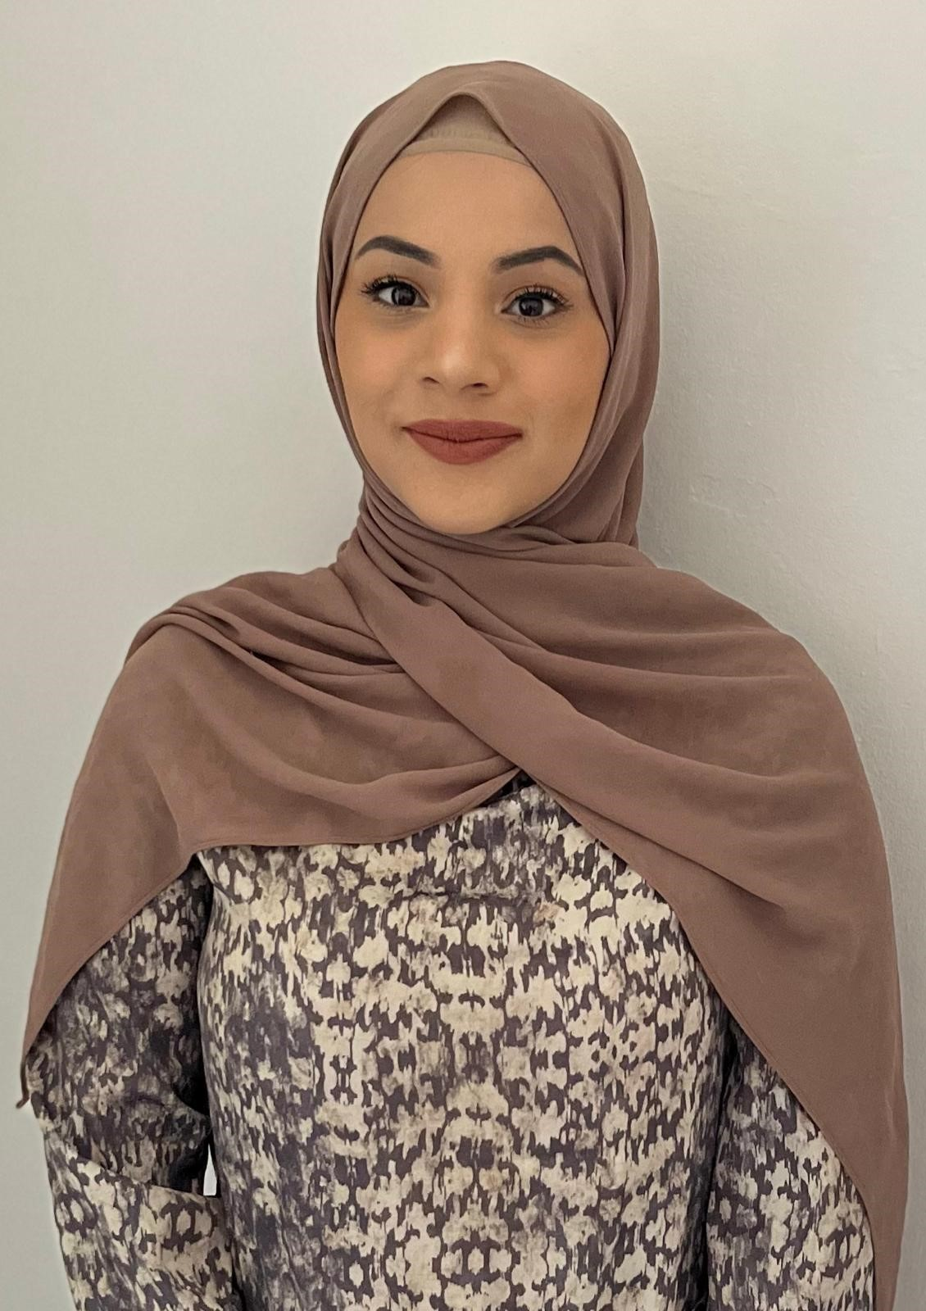
Who am I?
Yasmin Sultana
Community Engagement Worker
My job is to teach you about hunger and how you can help people in our town.
I run activities where you can take part, have fun and make a big difference in the lives of people in our town.
Show how teamwork and sharing can help make sure everyone has enough food to eat.

Slide 4
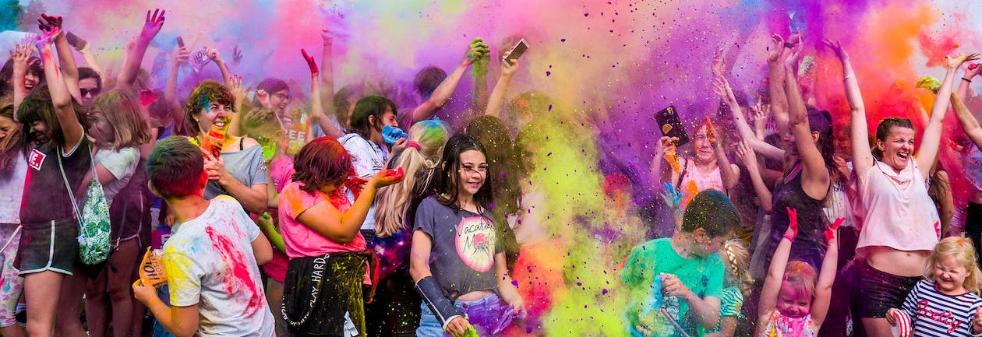

Primary Schools Colour Run 2024

Slide 5
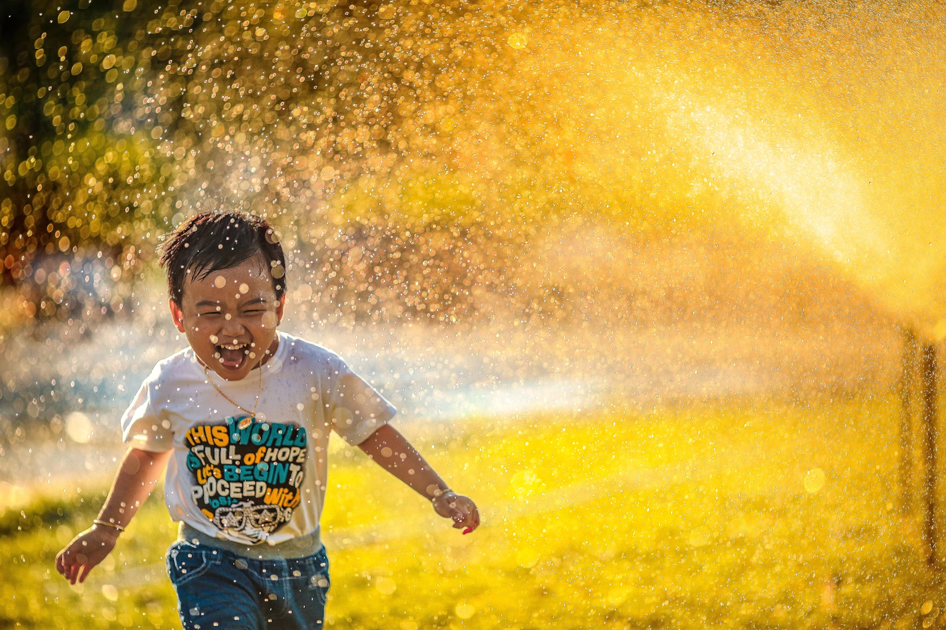
The Primary Schools School Colour Run is a fun event where you get covered in coloured powder!
Imagine running through a rainbow!

Slide 6

The Colour Run will take place right here at your school!
It’s on______________________
We will turn your school grounds into a colourful wonderland!

Slide 7
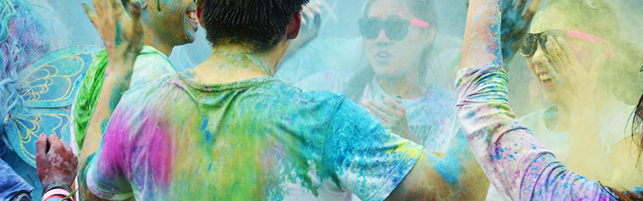
Ask your family and friends to help you by sponsoring your school’s Colour Run.
Put on clothes that you don't mind getting colourful and messy.
If you have sunglasses, wear them for a cool and colourful style.
Let's have fun together!

Slide 8
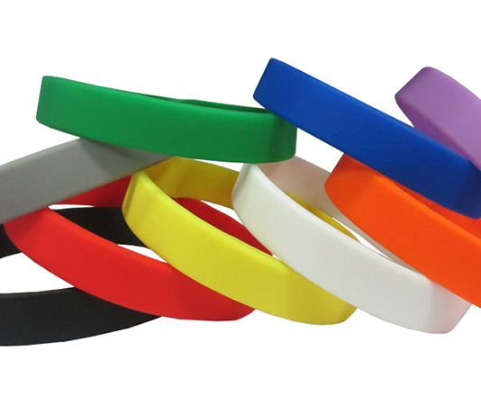

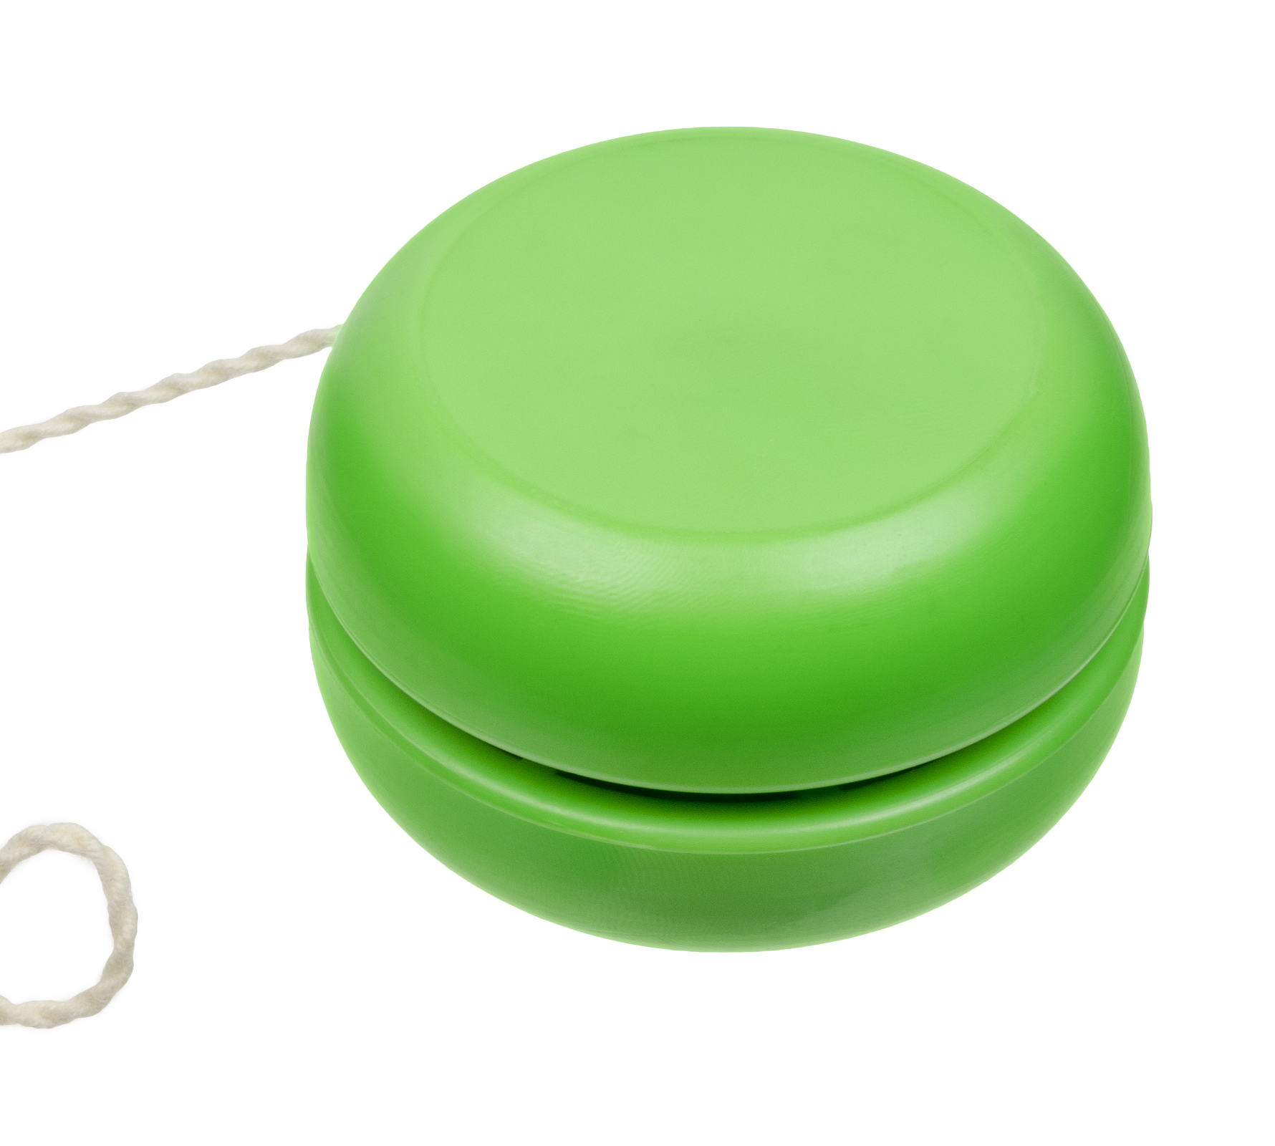
Win rewards
Every child receives a sticker and certificate for taking part.
Hit the £5 target for a special wristband.
Reach the £10 target to also receive a trendy yoyo!
Schools with the highest funds raised will win a trophy.
Child with the highest amount in the school will win a trophy.

Slide 9
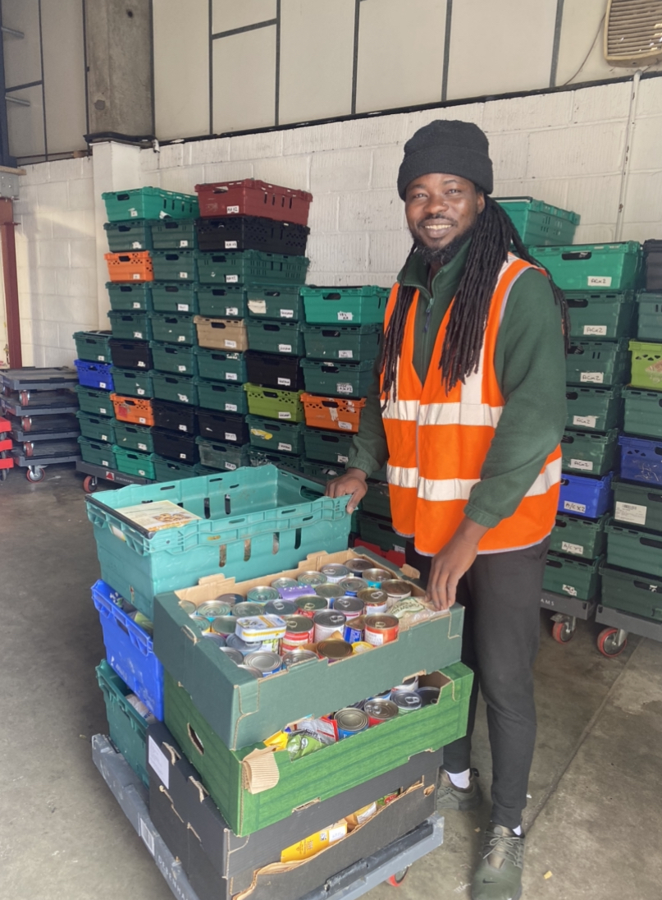
Join a fantastic event to help others.
Help stop holiday hunger.
Join schools already making a difference.

