Slide 1
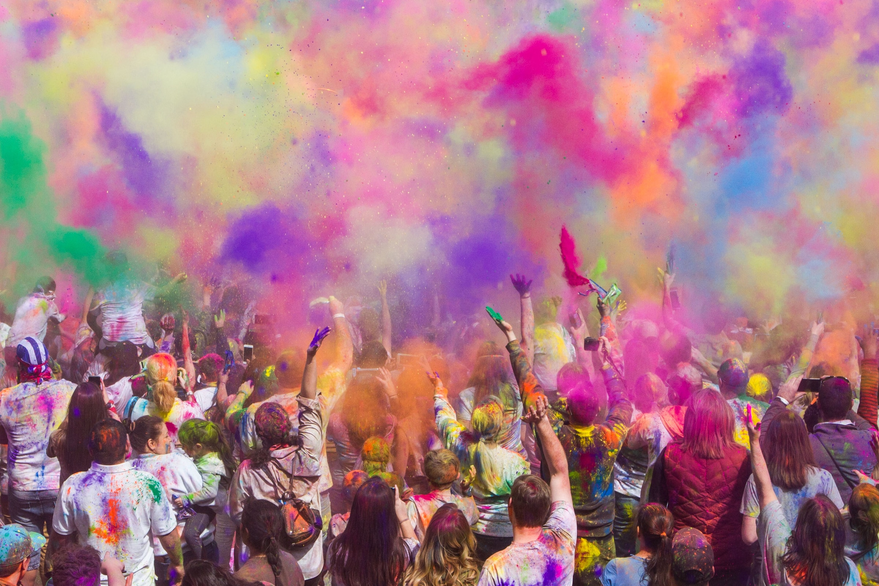
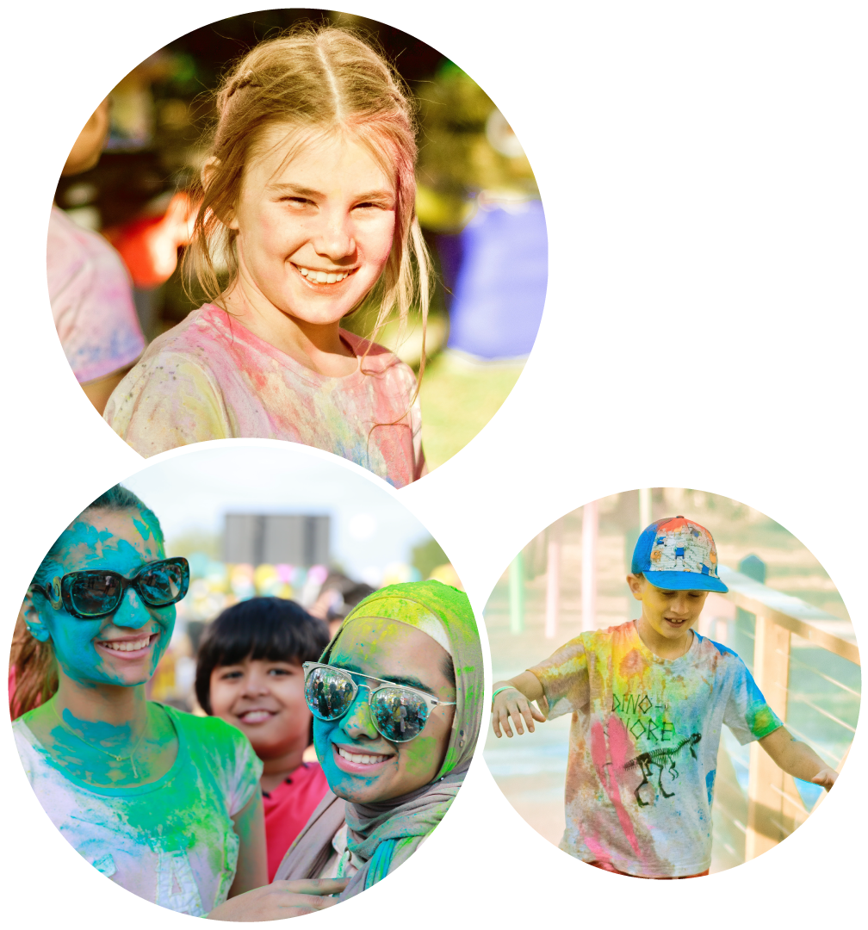
JOIN OUR PRIMARY SCHOOLS COLOUR RUN
SPONSORED BY:

Slide 2
Be a part of the Primary Schools Colour Run!
Join a fantastic event teaching kids to help others.
Help alleviate holiday hunger.
Join schools already making a difference.

Slide 3
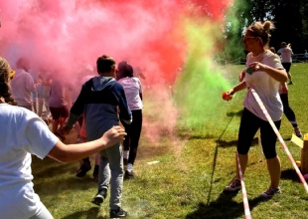
Event Details
and Logistics
The Primary Schools Colour Run will take place right at your school!
You choose the time, date, and duration of the run during our Fortnight of Action from Monday 3rd June to Friday 14th June.
Pupils come dressed in old clothes.
We supply everything you need for the event.

Slide 4
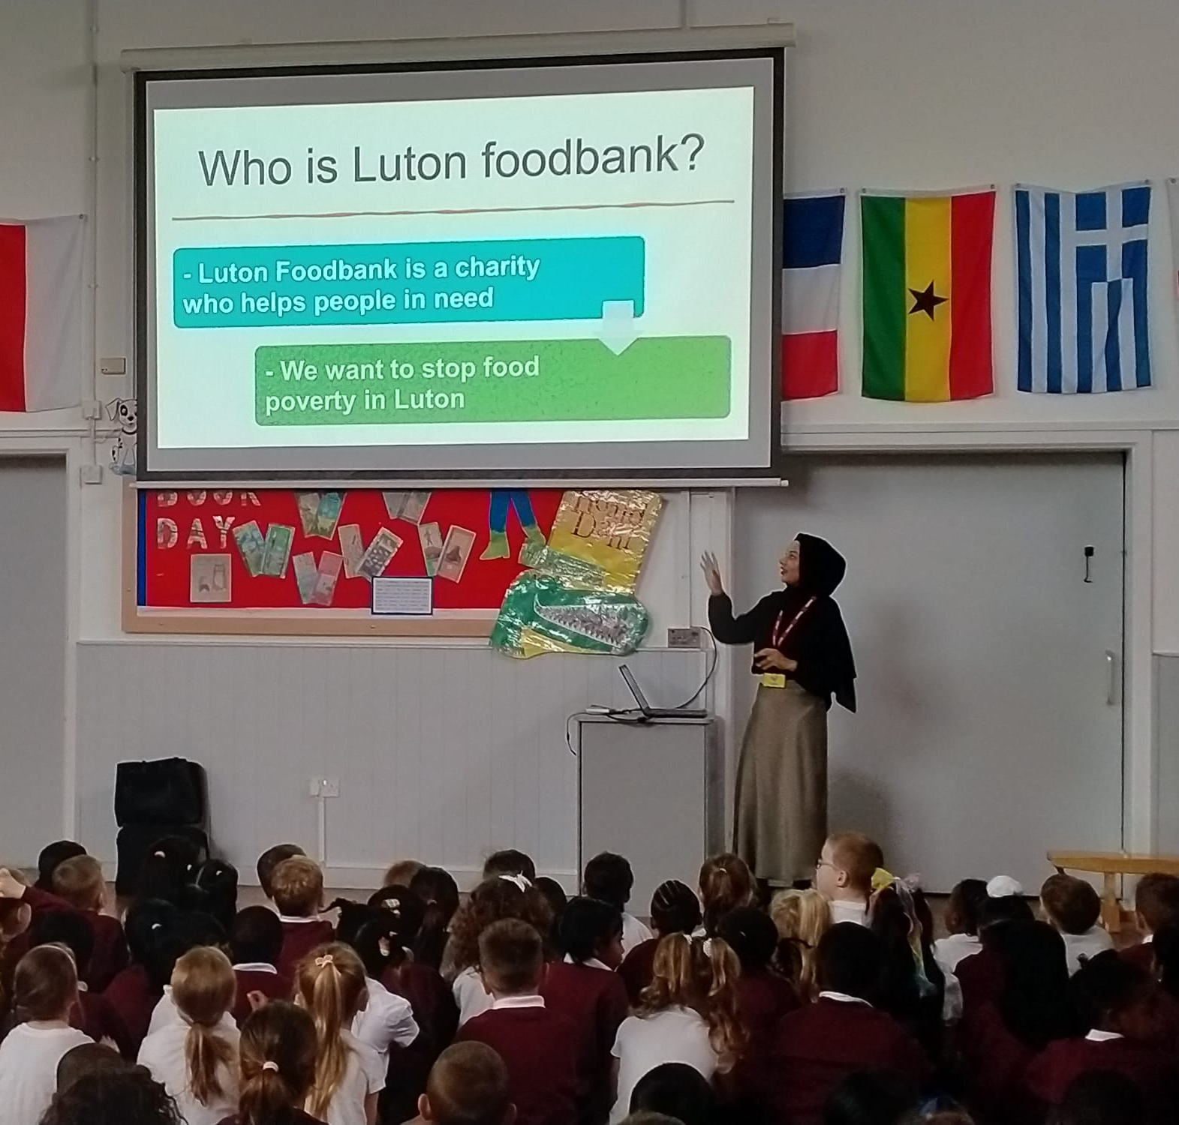
How your school can get involved
Simply sign up your school and book us to come and deliver an assembly to the children.

Slide 5
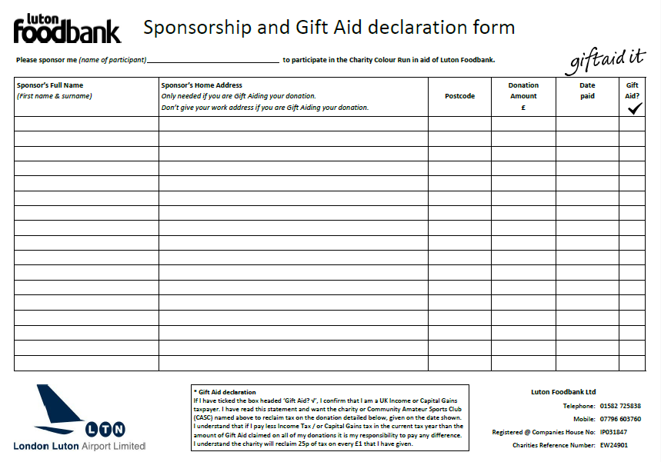
Fundraising
We will provide:
Sponsorship forms for cash collection.
A JustGiving link for online donations for each school.

Slide 6
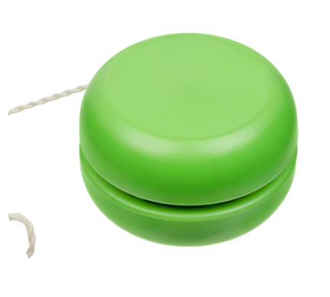
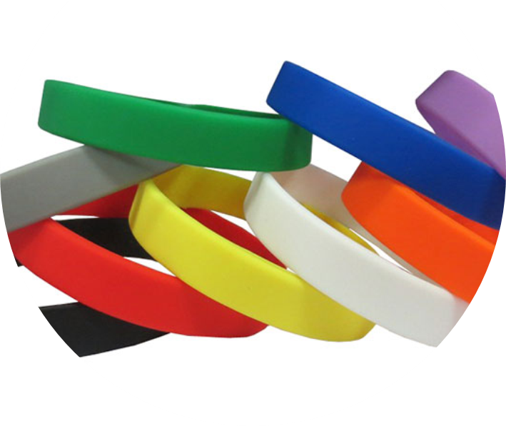
Primary Schools Colour Run Guide
We supply all the essentials for an unforgettable day.
Kids can earn exciting rewards for their fundraising efforts.
Every child receives a sticker and certificate for taking part.
Hit a £5 target for a special wristband.
Aim for a £10 target to also receive a trendy yoyo!
Schools with the highest funds raised will win a trophy.
Child with the highest amount in the school will win a trophy.

